Slide 1
Minnesota Archives Symposium
2015
Bridging the Gap Between our Digital and Physical Collections

Slide 2
Welcome
11:45am – 12:45pm: Optional Tour (Library, Archives, and Artifacts) – led by Lori Williamson, MNHS Collections
12:45 – 1:00 pm: Pre-Symposium Coffee and Mingle Break, sponsored by the Midwest Arts Conservation Center

Slide 3
Welcome to the
4th annual Minnesota Archives Symposium
2015

Slide 4
Session one
Looking at the collection from all angles: Interactive representations of collection objects at the UW- Stout
Presenter: Heather Stecklein, University of Wisconsin-Stout

Slide 5
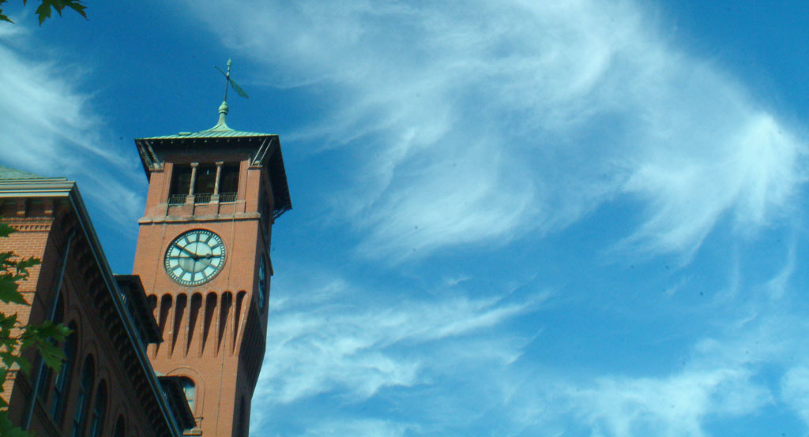
Looking at the Collection from All Angles:
Interactive Representations of Collection Objects at the UW-Stout
Heather Stecklein
Archivist, UW-Stout Archives/Area Research Center

Slide 6
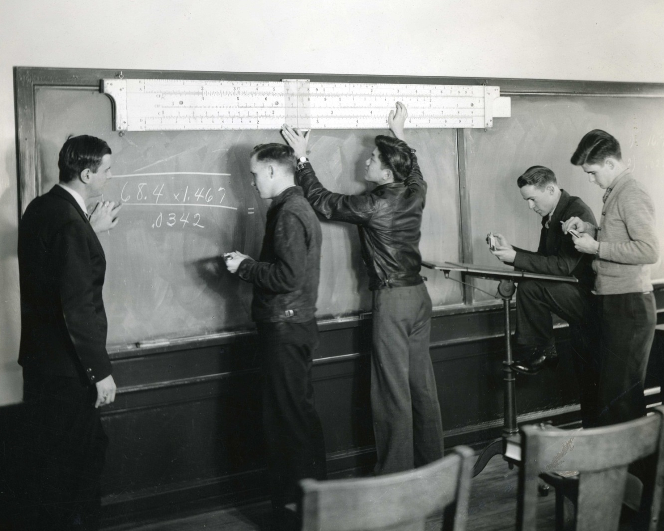
About Stout
POLYTECHNIC UNIVERSITY
SPECIALIZED PROGRAMS
Apparel Design
Plastics Engineering
Game Design
Vocational Rehabilitation
UNIVERSITY ARCHIVES
Collections date back to the 1890s
Located in the University Library

Slide 7
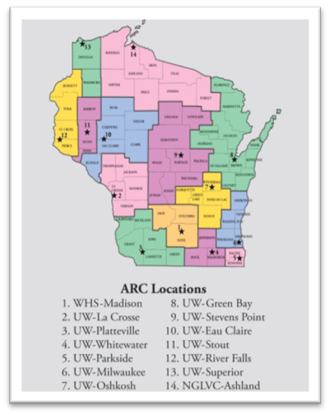
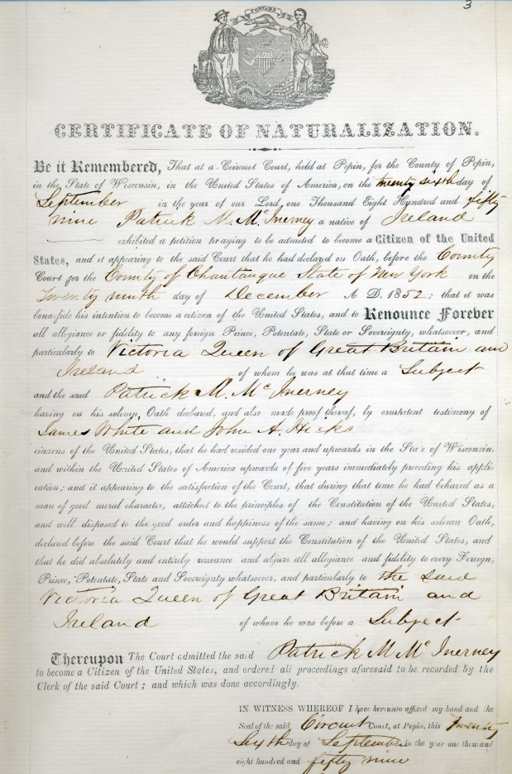
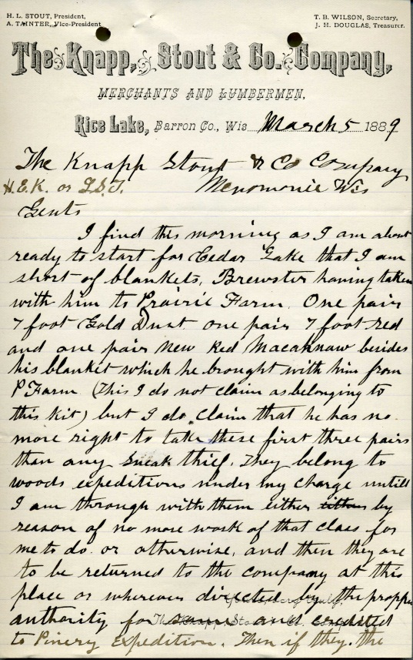
The Area Research Center

Slide 8
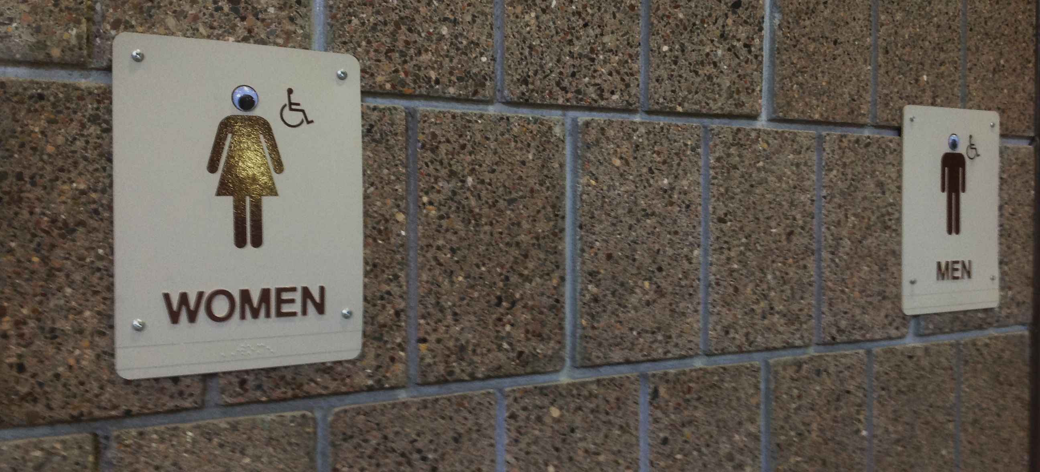
How do we engage our unconventional students?
Applied Arts Building, UW-Stout

Slide 9
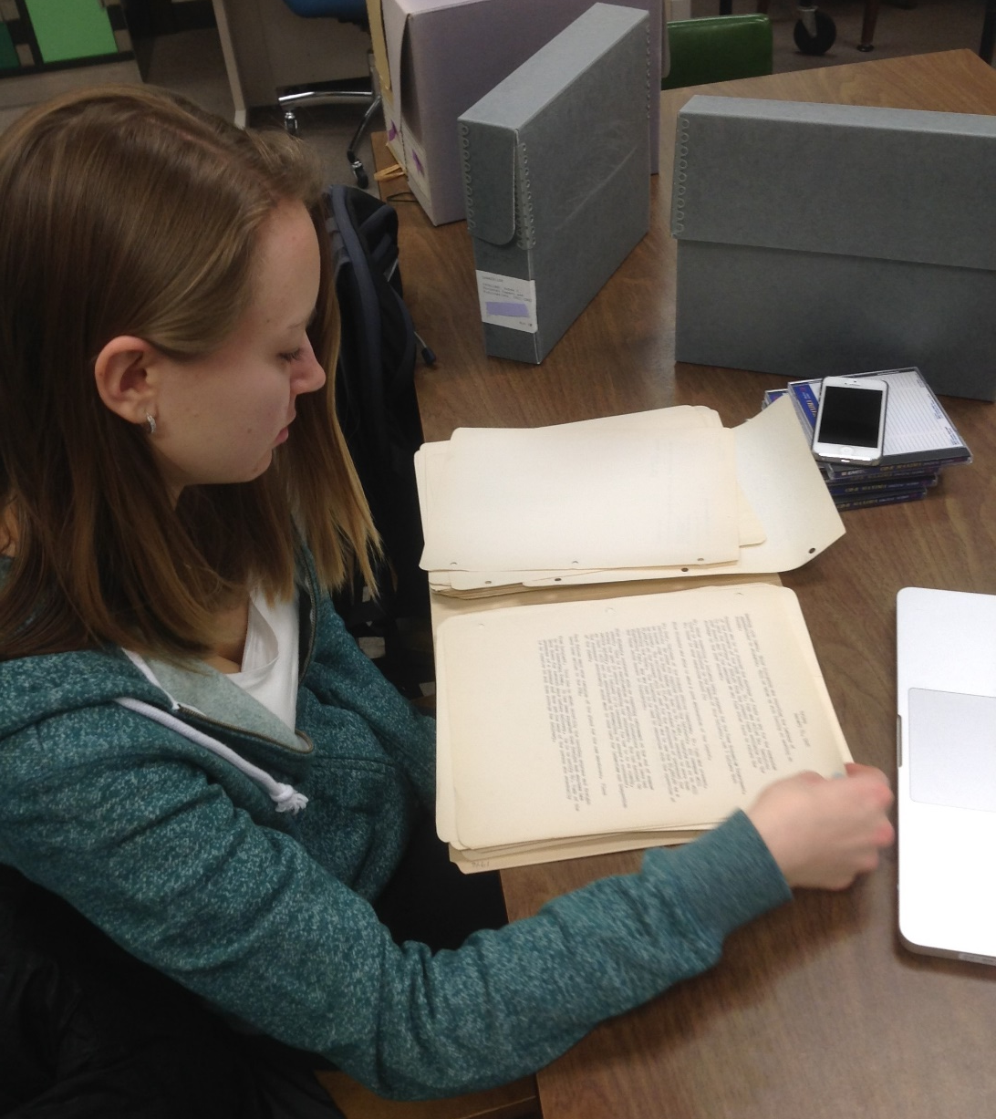
Persuade them to interpret archival collections
using their own skill sets
Collaborate with faculty and students
Facilitate applied learning projects relevant to their fields
Lauren amasses information about a 1940s faculty member
who was animated in the Harvey video game

Slide 10
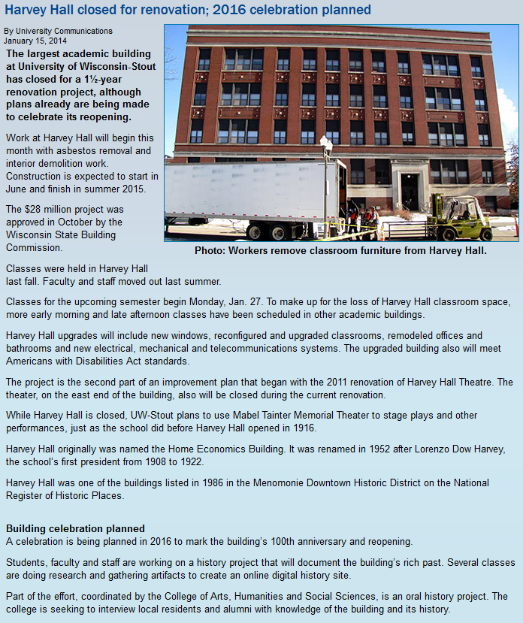
Major renovation of the structure
Reopening in 2016—
On the building’s 100th anniversary
Coincides with the 125th anniversary of campus
The Harvey Hall Digital Humanities Project

Slide 11

Harvey Hall Centennial Committee
Dean of the College of Arts, Humanities, and Social Sciences
Cross-campus committee
  5 faculty members
  Alumni Director
  Director of the Campus Art Gallery
  University Archivist
Develop programming to celebrate the building’s reopening in 2016
Fundraising, oral histories, history harvests, and student coursework
Interpret Harvey Hall’s history using the unique skill sets of Stout students

Slide 12
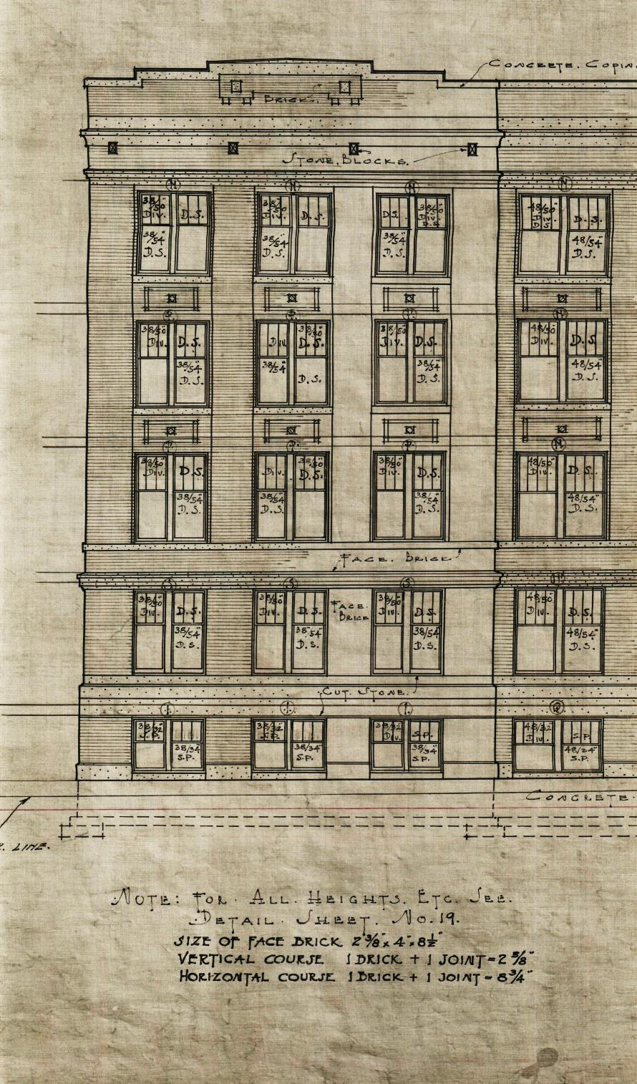

Harvey Hall
Classical Revival Style
Listed on the National Register of Historic Places
  Part of the Menomonie Downtown Historic District (NRHP-1986)
Designed by John D. Chubb and Associates
  Specialized in public schools in the Midwest
The Harvey Hall Centennial Project
Inspiring Innovation Learn more at www.uwstout.edu

Slide 13
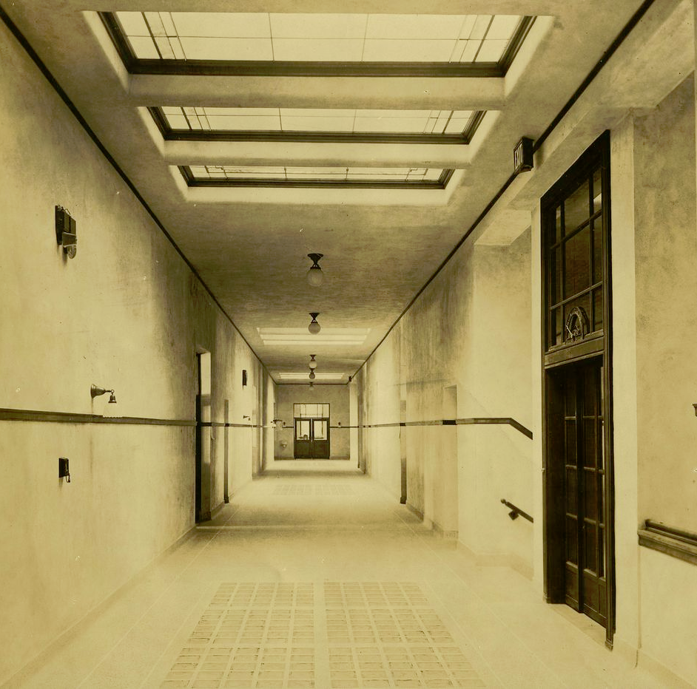
Architectural Features
Skylights
Glass block floor panels
Glass walled elevator shafts
Terrazzo flooring
The Harvey Hall Centennial Project
Inspiring Innovation Learn more at www.uwstout.edu

Slide 14
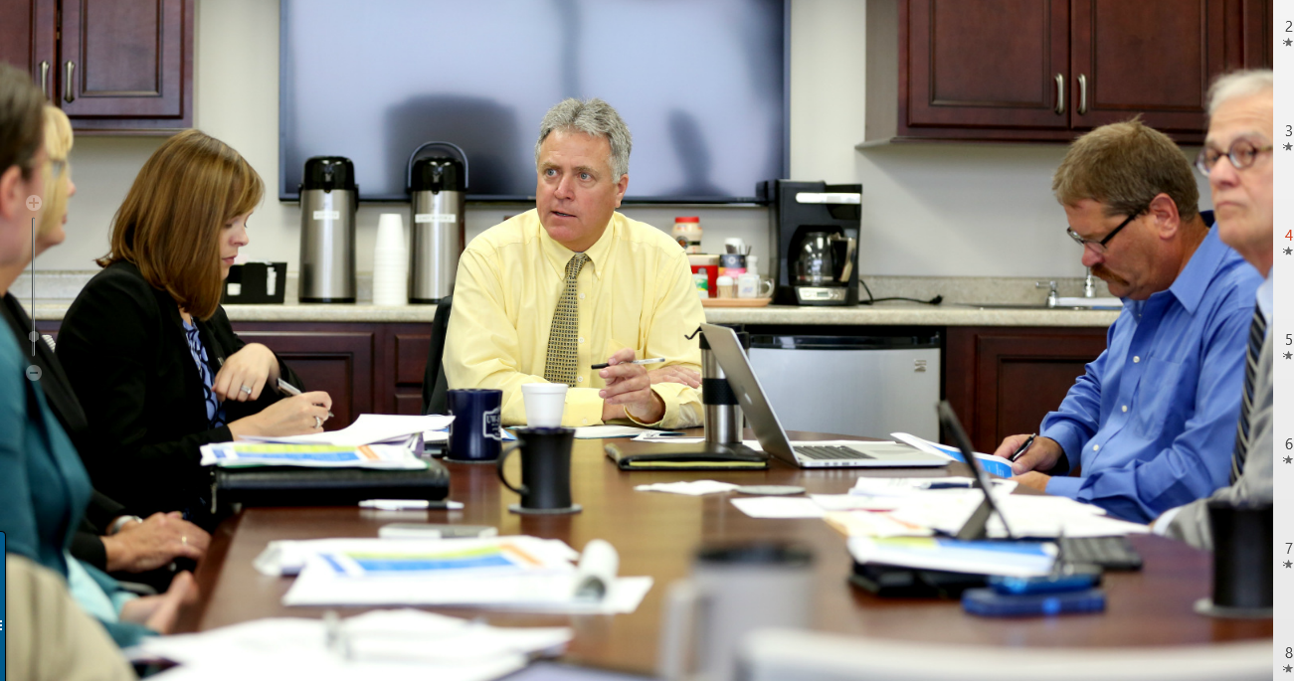
How we recruit faculty to develop class projects in the Archives
Infiltrate departmental meetings
Proselytize the utility of Archives at new faculty orientation sessions
Conduct workshops at faculty development sessions
Approach faculty with courses related to collections and existing projects

Slide 15
Sample Student Projects to date

Slide 16
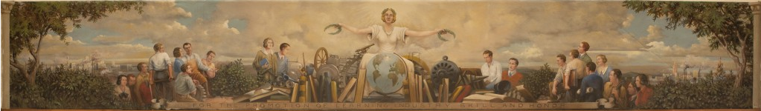
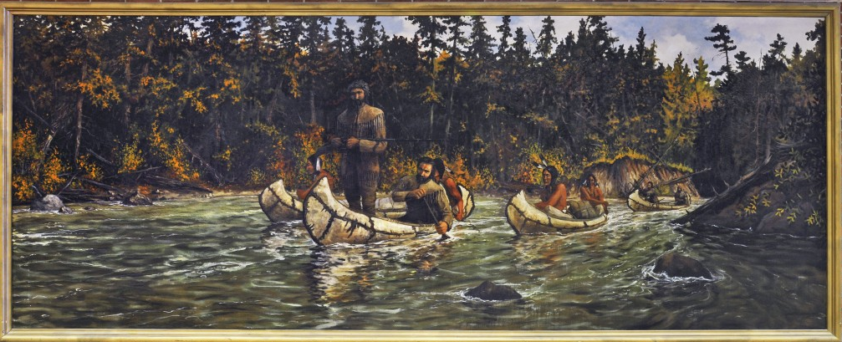
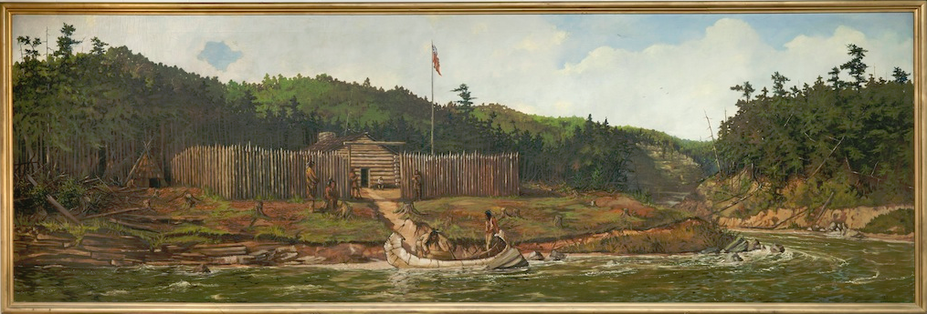
Cal Peters Murals
WPA Artist in residence at Stout, 1935-36
Created 4 large murals and a variety of small landscapes
Murals all housed in Harvey Hall

Slide 17
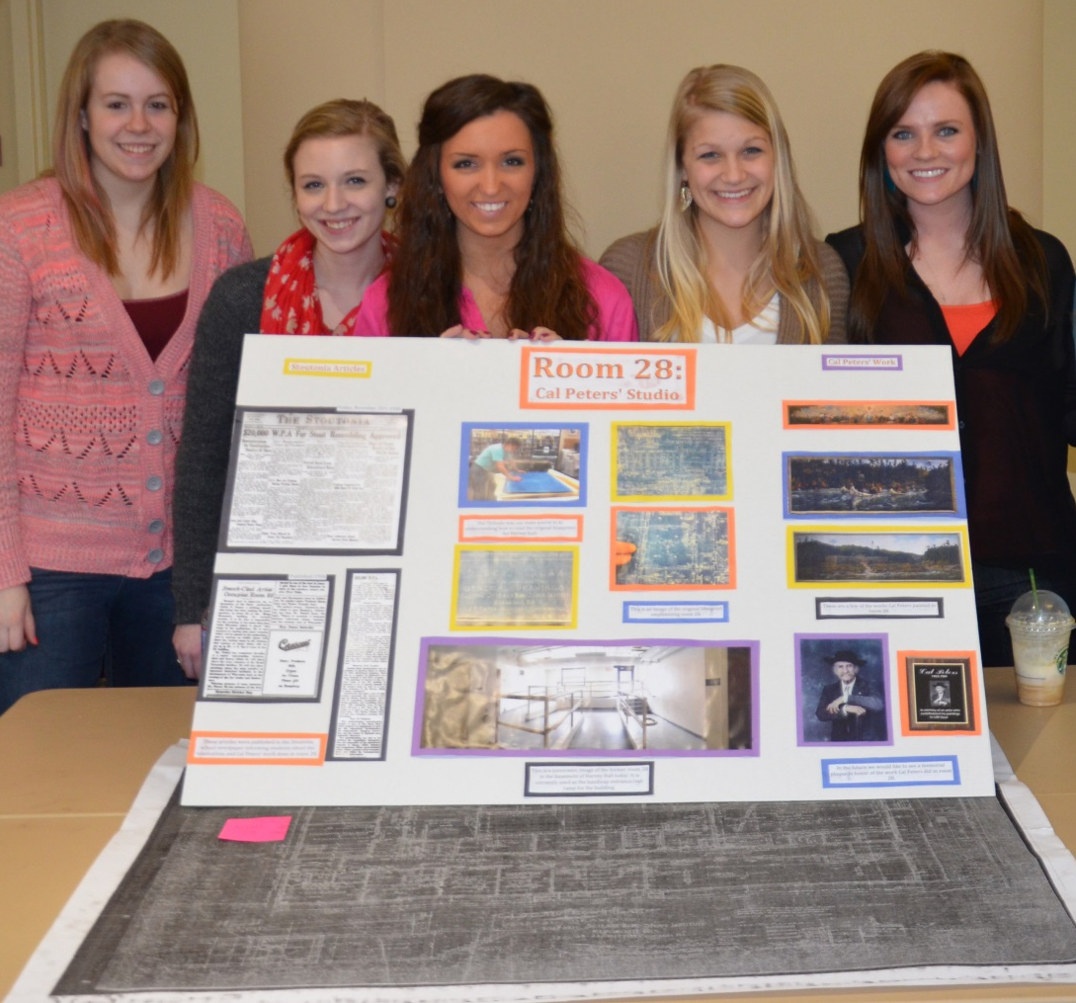
English 102: Art and Design Living and Learning Community

Slide 18
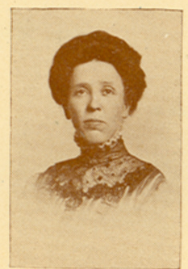

Example Student Project, English 113
Kori Klaustermeier
Noted similarity between central mural figure and Stout professor Mabel Leedom
Connected other central figures to 1930s Stout faculty
Presented findings at the National Collegiate Honors Conference in 2013

Slide 19
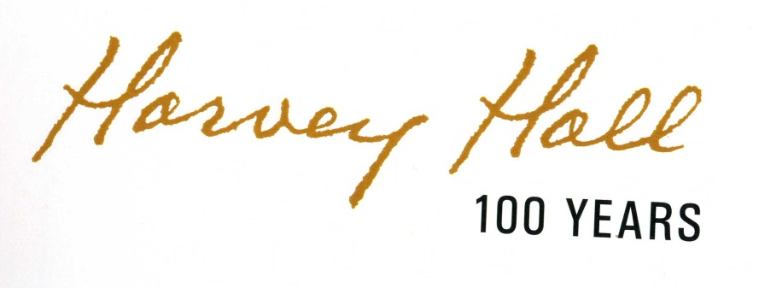
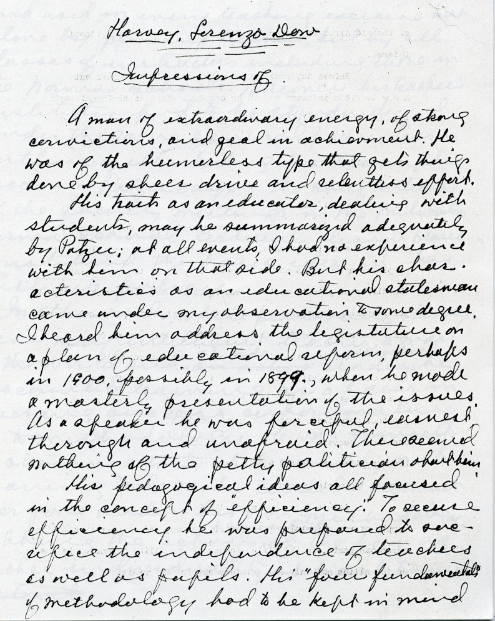
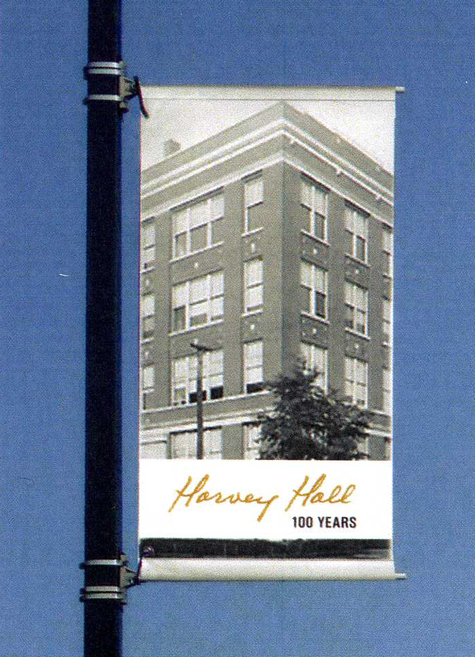
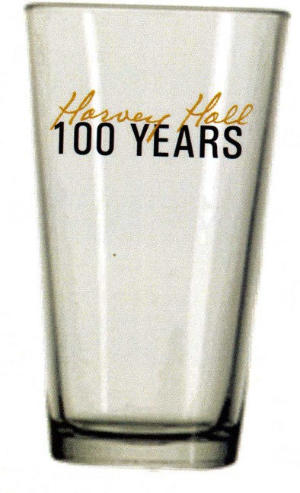
Sample Student Projects:
Design 388
Typographic Design
Cody Hartleben drew from samples of the words “Harvey Hall” in
handwriting in UW-Stout Archives collections to create a font and logo design.

Slide 20
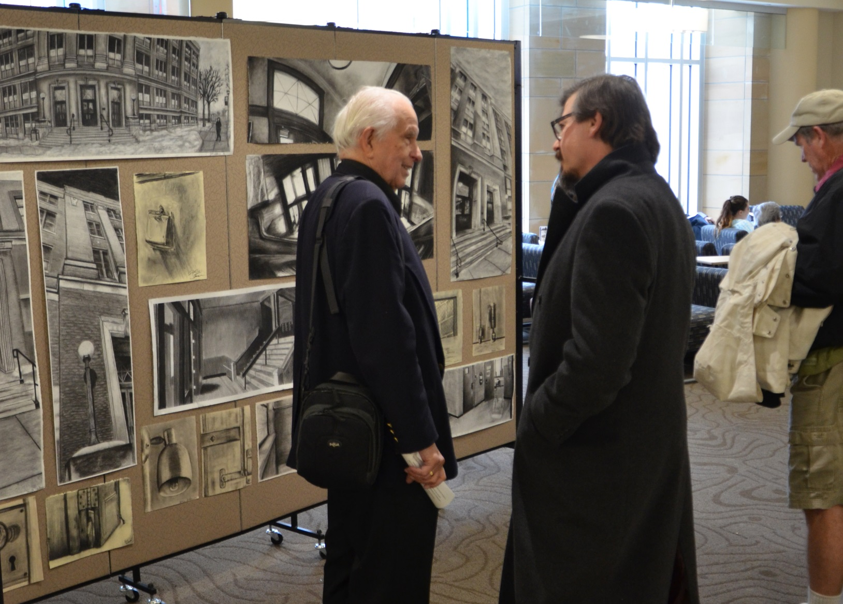
Art and Design
Panorama Drawings Exhibit

Slide 21
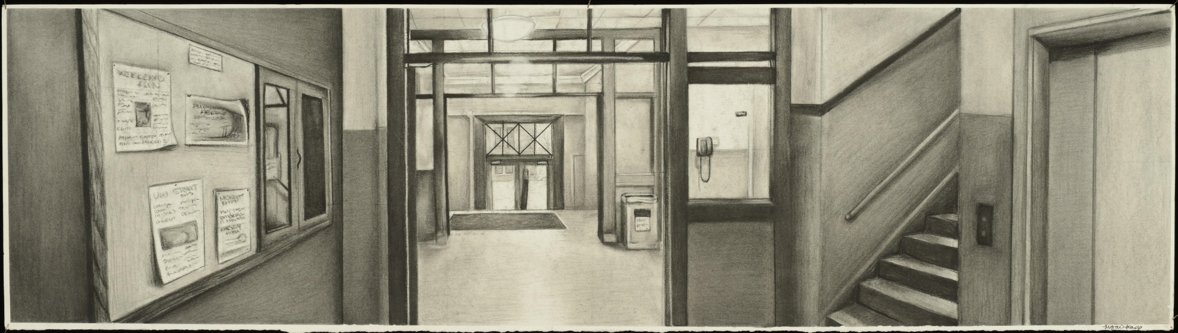
Sample Student Projects: Art and Design
Panorama Drawings

Slide 22
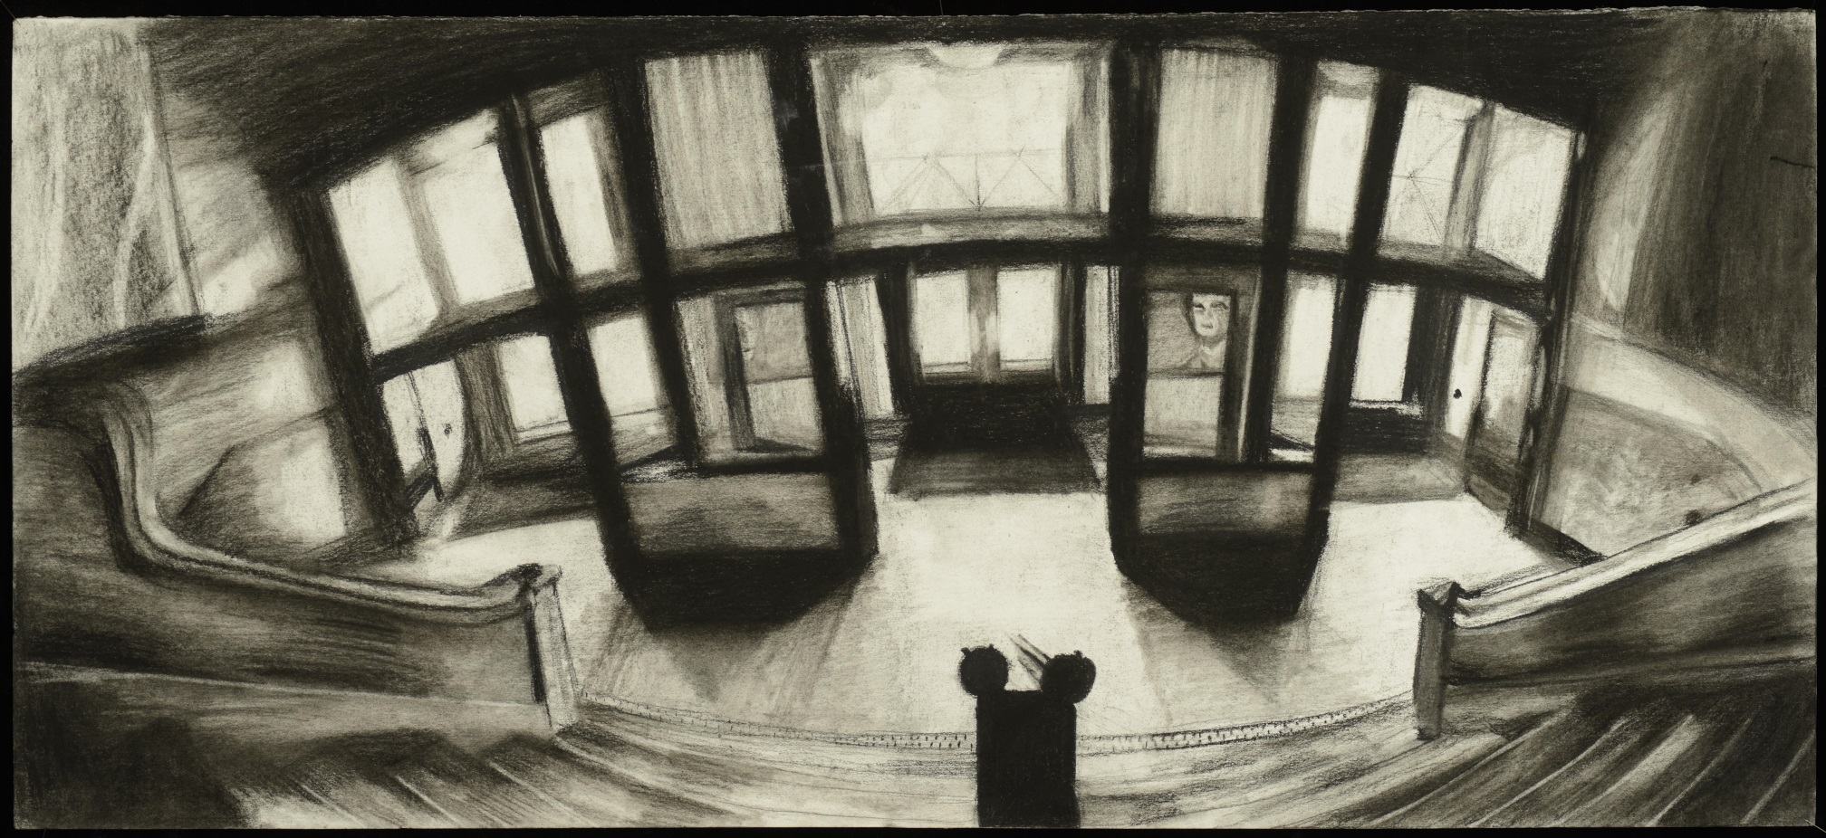
Sample Student Projects: Art and Design
Panorama Drawings

Slide 23
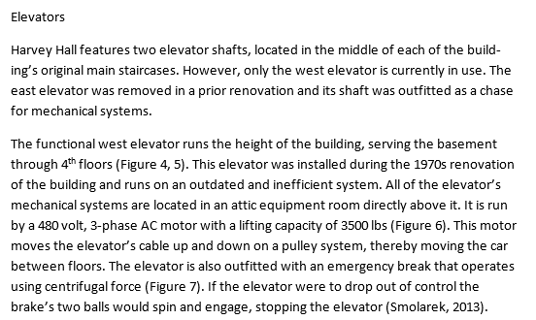
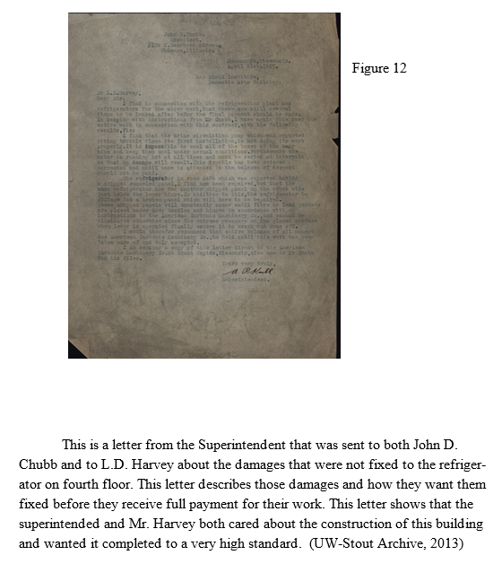
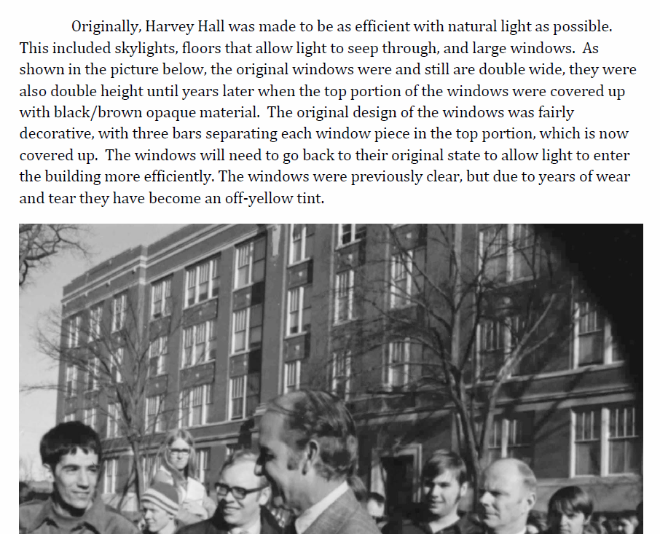
Construction SMGT 750: The Built Environment
Two sections of the same class—each tasked with creating a historic structures report
(A common practice among architects and construction firms)
We did not show them the report created by the architectural form for the existing project
3 teams:
History
Architecture
Construction

Slide 24
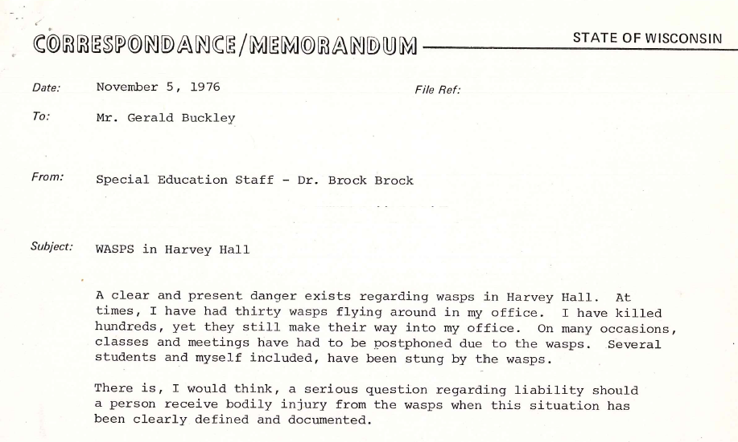
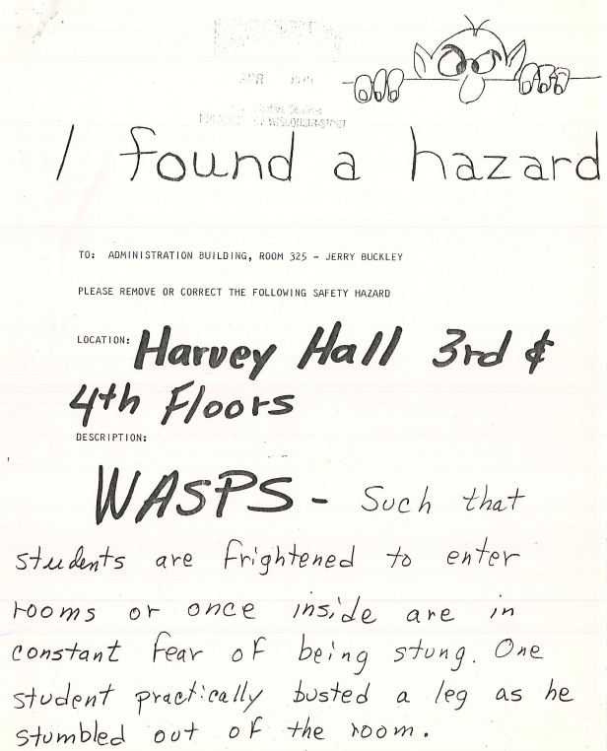
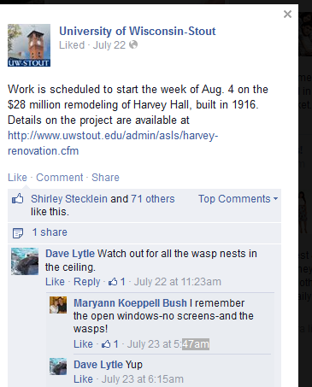
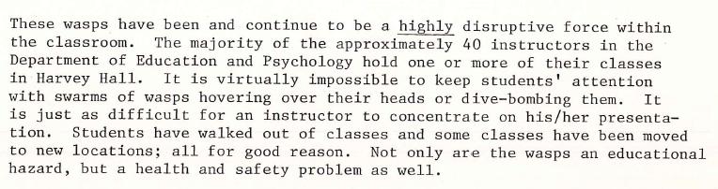
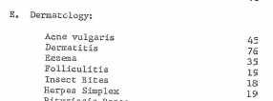
Bio-355: Entomology
Investigation of Wasp Infestations
Identified the species of wasp, its habits, and potential future distribution on campus
Building and Maintenance Files
Interviews with Alumni
Student Health Office
Annual Reports

Slide 25
The Harvey Game:
An interactive representation of Harvey Hall during the 20th century

Slide 26
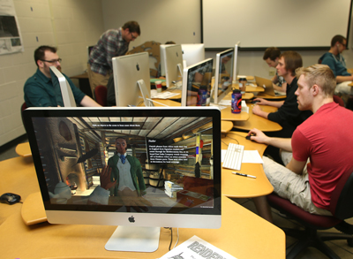
The Virtual Harvey Hall Team
Mission:
Interpret facets of Harvey Hall’s history using cross-campus, interdisciplinary voices
Fall 2014
Interactive Environments Workshop Des 256
Design students begin to build the virtual space, creating locations in which to embed digital artifacts.
Spring 2015
Interactive Environments Workshop Des 256
Digital Humanities Seminar Engl 480
Digital Humanities students collect, research, and curate digital artifacts to incorporate into the virtual space. Students in the two courses collaborated on the design and refinement of the virtual space.
DES 373: 3D Modeling & Animation III (both semesters)
Digital Cinematics Class: Created cinematic introductory and cut scenes

Slide 27
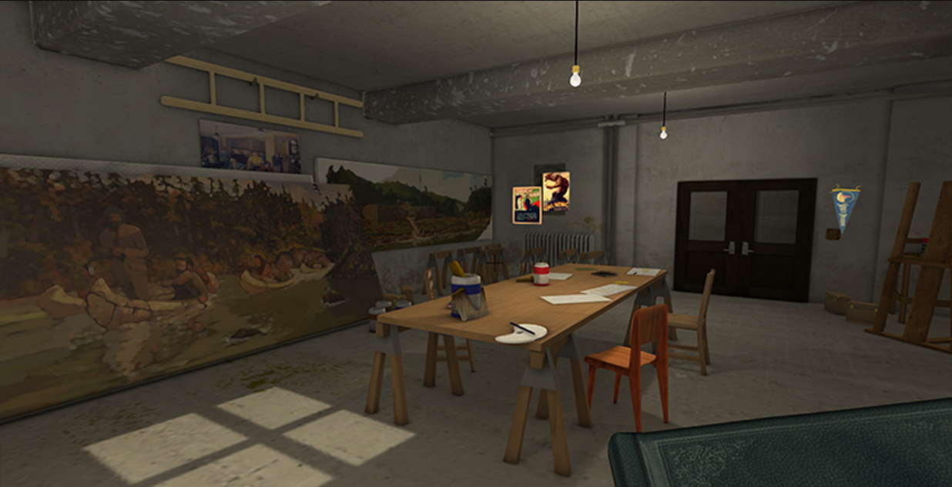
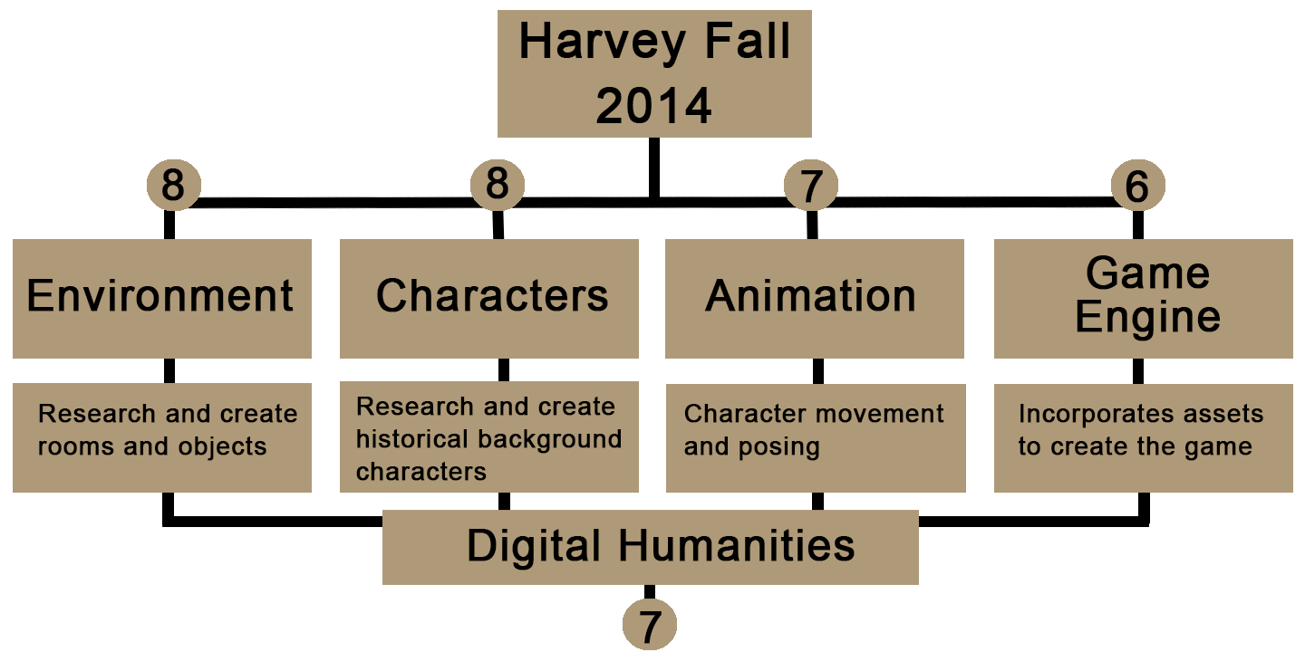
Harvey Game
Fall 2014
Major accomplishments
Defined temporal/physical scope
Identified characters who will inhabit the space
Amassed a tremendous amount of data about the animated spaces and people
Notes:
Emily
A little about the breakdown of the teams
Previously stated, started with Dig Hum and 3D 3 classes, 22 3D artists, 7 Dig Humanists split into 4 groups.
Env. Artists create rooms, tables, desks, chairs, props, etc. anything that would be considered ‘hard surface’/non living
Char Arts create historical people (Harvey, Cal Peters, Minnie Becker to name a few) as well as ‘extras’ to make Harvey feel real, populated
Anim take characters, make them move and sit, smoke, sneeze etc. w/o, characters would just be “T-posed” (explain)
Game Engine team builds the game. Sets the stage, does the lights, makes objects interactible, makes it so you don’t fall through floor or walk through walls and much, MUCH more.
Digital humanists, or as we call them, DH’ers, are interspersed to do research for each team, provide references, worked together as a class instead of individually--unusual for capstone project

Slide 28
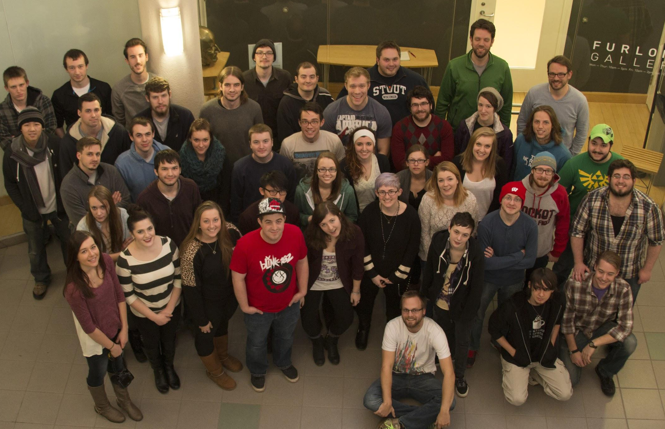
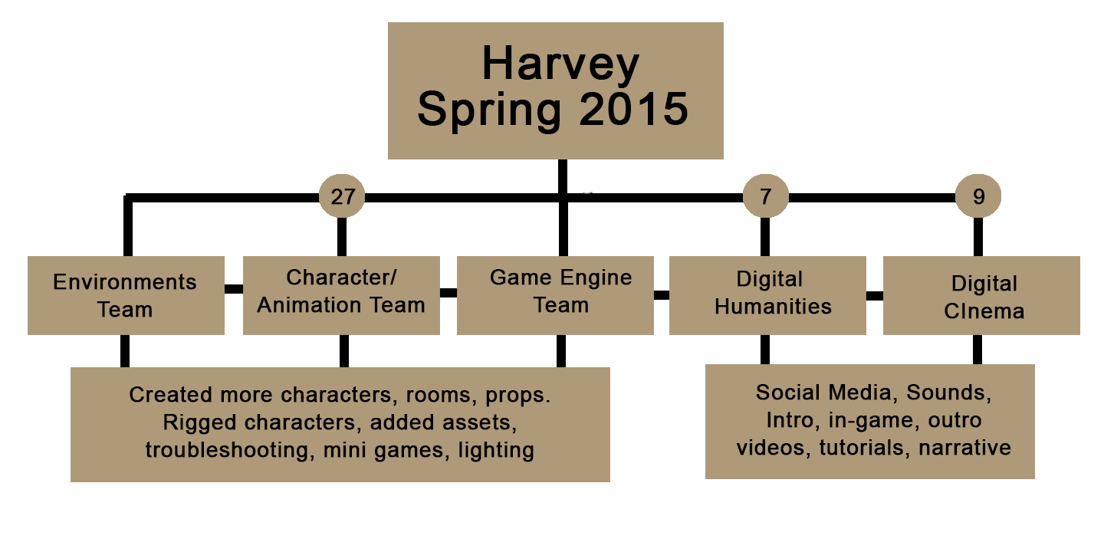
Spring 2015
Major accomplishments
Refined and completed interactive spaces and contents
Created cinematic sequences
Created mini-games and missions to propel gameplay
Notes:
Emily
With the + of Cinema, the Humanities studs focus on social media, promotion, sounds.
The cinema students began work on live action Intro/outro sequence, and filled a very important narrative hole in the project.
Harvey was originally more of a digital museum than an actual ‘game’ and it was the addition of the cinema team that added the key element of a driven story and goal to follow to completion.
There’s a lot of exciting content therein, so I’ll hand the floor over to Nick who will tell you more about!

Slide 29

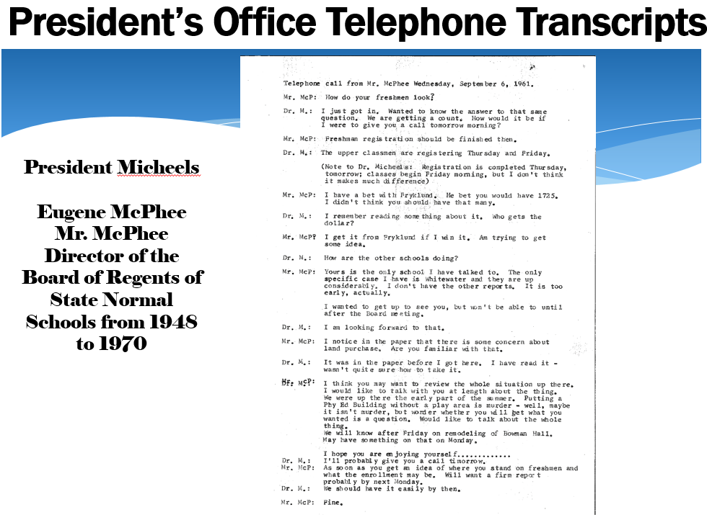
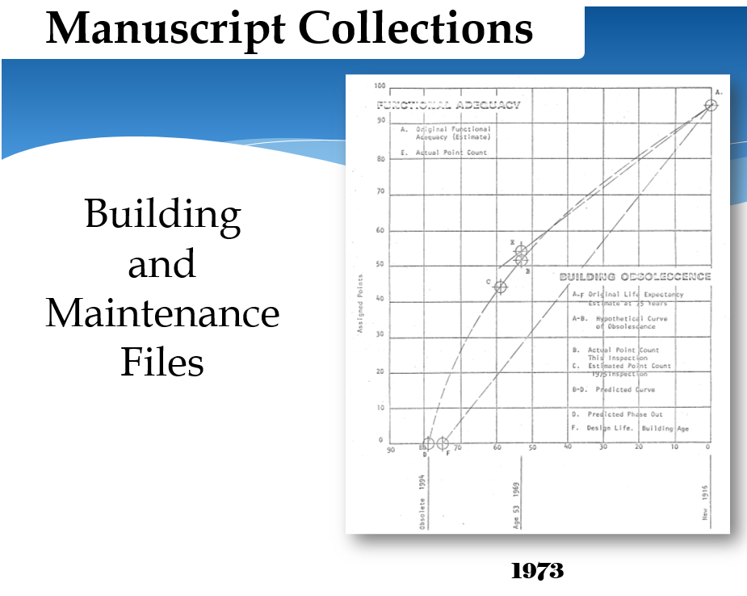
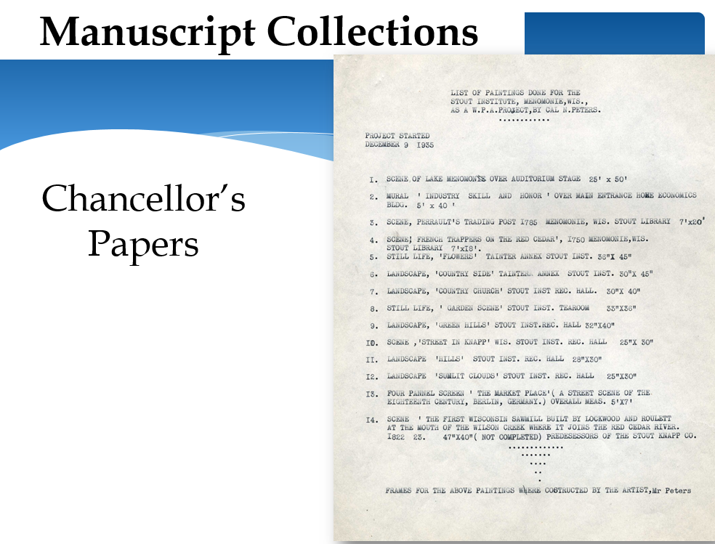
Orienting the students to the materials
60 minute orientation to types of useful archival resources—centered around research questions

Slide 30

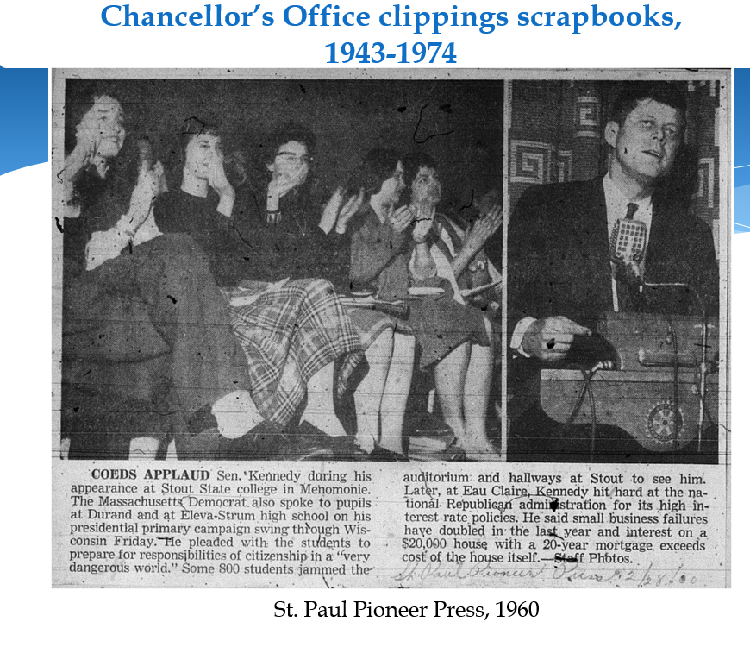
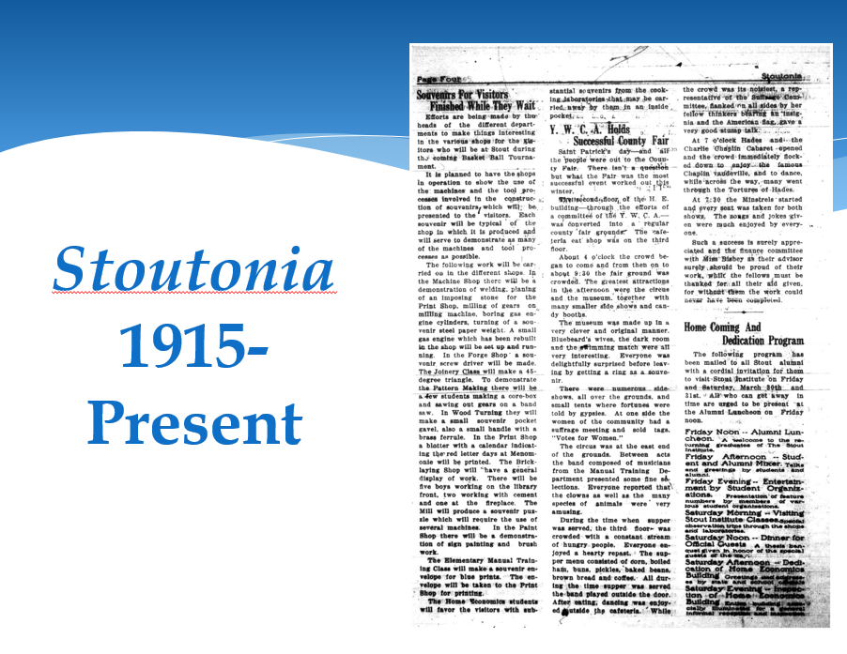
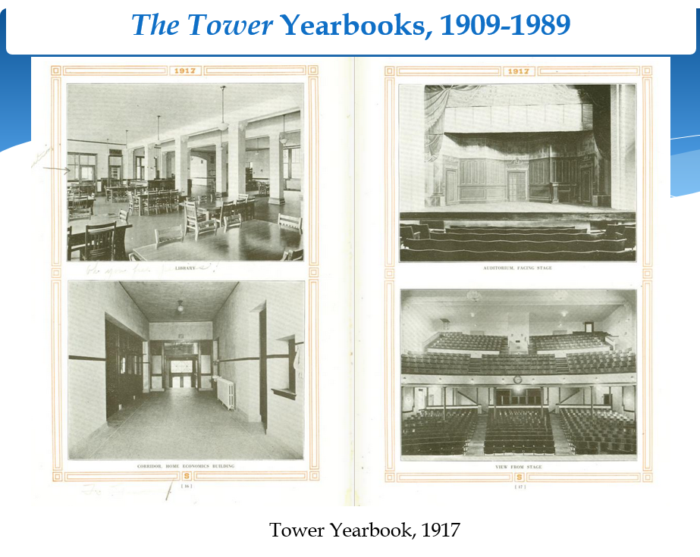
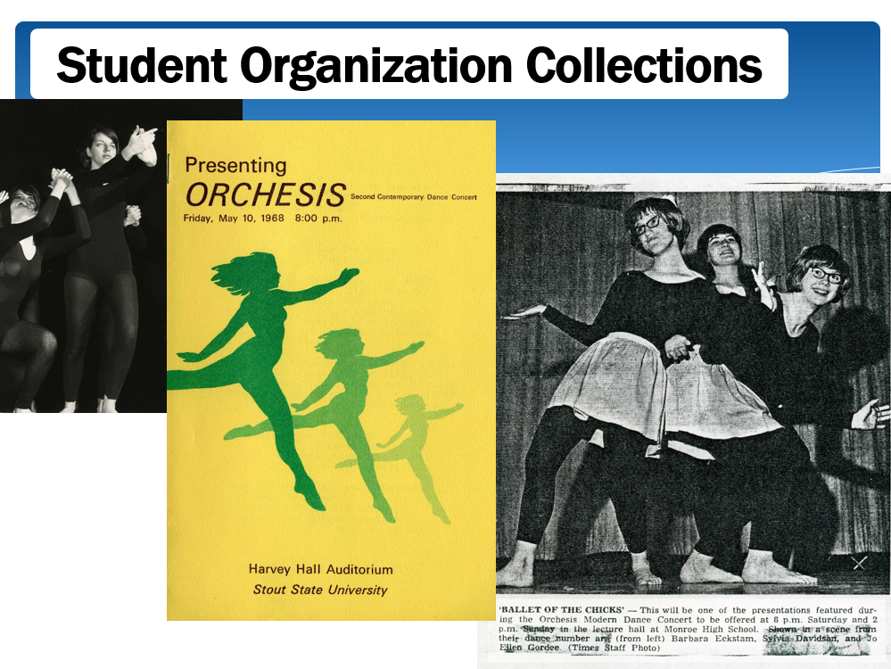
Orienting the students to the materials

Slide 31
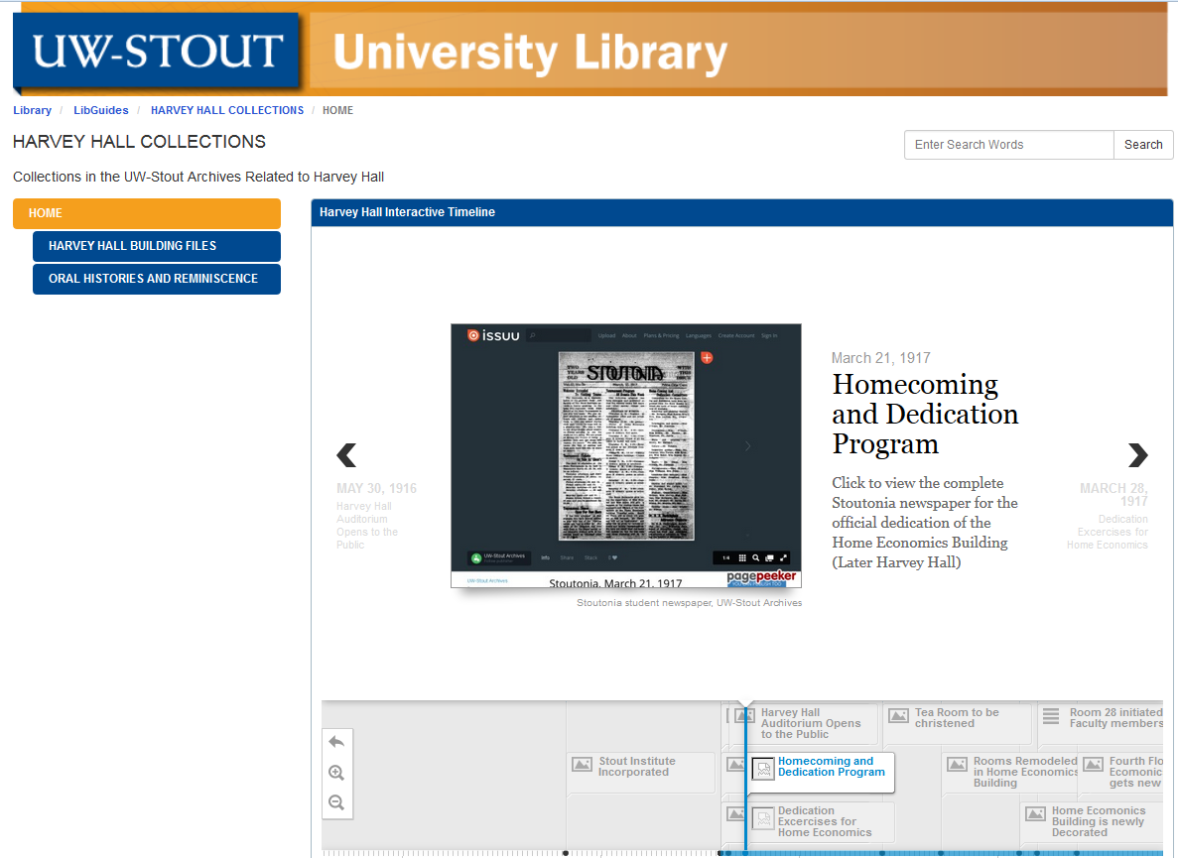
Orienting the students to the materials
LibGuides Page
Directs students to select resources
Interactive Timeline of events

Slide 32
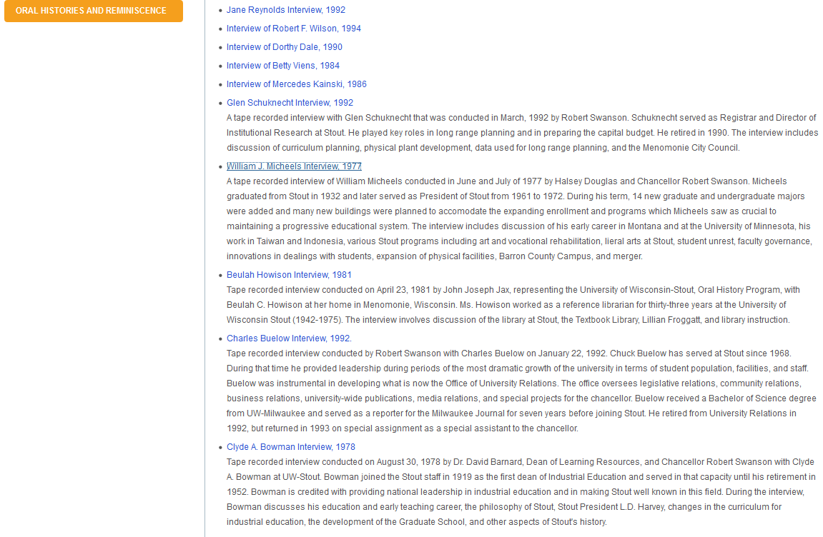
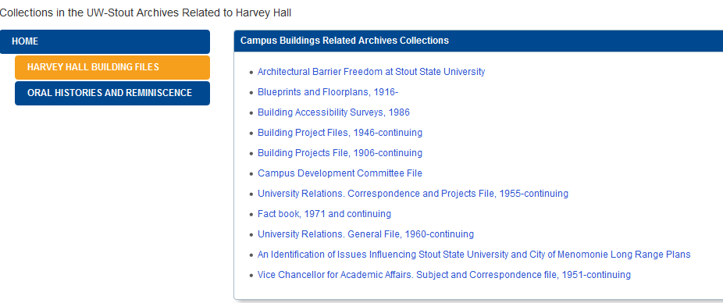
Orienting the students to the materials
LibGuides Sub pages
Persistent WorldCat URLS to collections pages

Slide 33
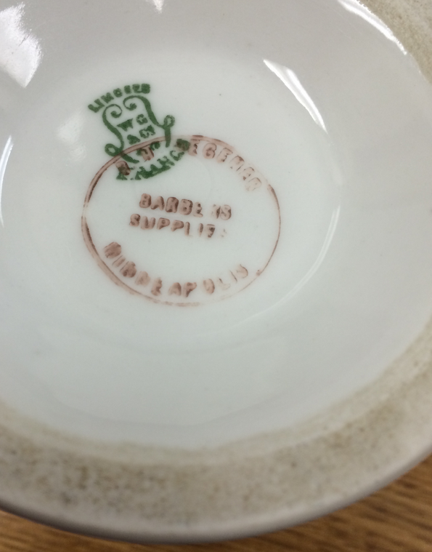
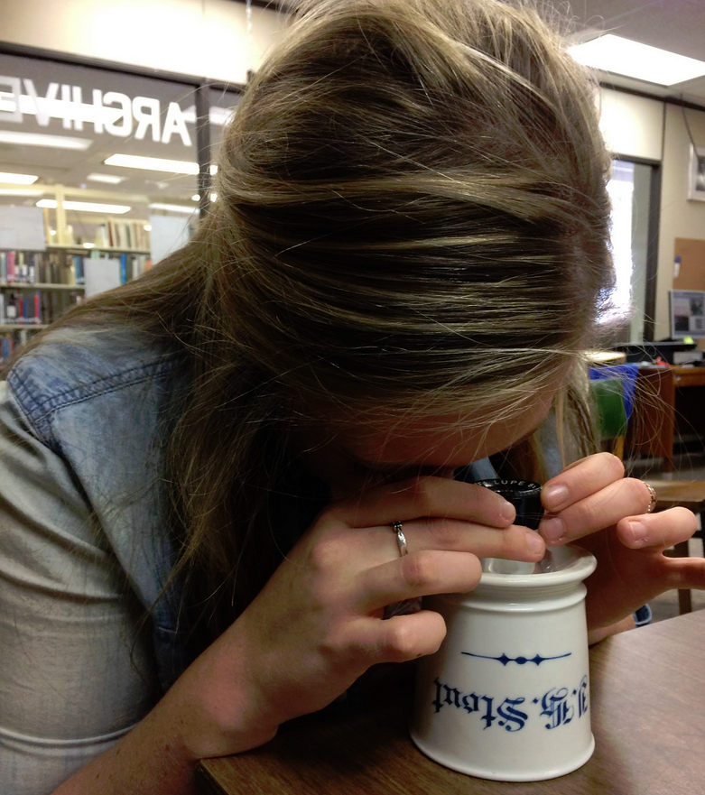
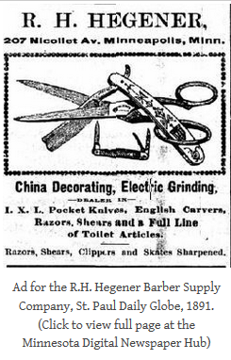
Students at Work
Digital Humanities Students:
Our Resident Researchers!
Investigated potential rooms and characters
Collaborated with design students to refine the scope
Investigated, substantiated, and illustrated the objects and individuals that populated each room
Used the Stout Archives and external resources

Slide 34
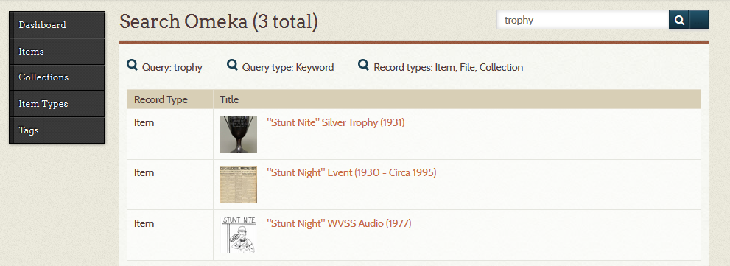




Omeka database for Harvey Hall content

Slide 35




Character animation process

Slide 36

The Harvey Game
Harveygame.com

Slide 37
Photogrammetry: Interactive Objects

Slide 38

Computer Graphics Modeling using Photo Scan
Summer 2015: Photogrammetry
Seth Berrier, Ph.D.
Computer graphics with a focus on computational photography and light
field rendering.
Photogrammetry scans a material’s
reflectance properties in addition to shape and color.

Slide 39


Summer Photogrammetry project
Computer programming students and 3-D Modeling Students
About 70 objects captured from
The UW-Stout Archives collections
About 30 objects ( from external collections related to our university) shot onsite

Slide 40


Resurrecting Academic Ancestors:
Digital models of student projects
Digital model of twentieth century
student metal work in the Archives
Stout Institute foundry, circa 1930

Slide 41





Forged tools, Stout 1924

Slide 42


Upcoming Project: Forging Objects Tools
Forging Metal in the Stout Foundry Shop
20th Century
Replicating the objects in the Stout Fab Lab
21st Century

Slide 43


We’ve created this buffalo…
Now let’s use every piece of it!
Photogrammetry data will inform upcoming research and programming
Mathematical research in rendering light fields
Software development programming students perfect distribution software for the artifact models

Slide 44
Be Brazen!
Embrace the challenge of engaging your
collections in applied learning projects
The payoff is extraordinary for both the archives
and the students

Slide 45

UW-Stout Archives and Area Research Center
HEATHER J. STECKLEIN
steckleinh@uwstout.edu
https://twitter.com/hjstecklein
VIEW OUR COLLECTIONS
http://uwdc.library.wisc.edu/collections/UW/UWStout
https://archive.org/details/universityofwisconsinstoutarchives
www.facebook.com/UWStoutArchives
www.twitter.com/uwstoutarchives
harveygame.com

Slide 46
Coffee and Mingle Break – Optional tour
Sponsored by Hollinger Metal Edge
2:15 – 2:45pm
Optional Tour (Library and Archives)

Slide 47
Session two,
Part one
Finding Aid, Meet Facebook
Presenters: Sarah Barsness and Anjanette Schussler, Minnesota Historical Society

Slide 48
Finding Aid,
Meet Facebook
Sarah Barsness and Anjanette Schussler
Minnesota Historical Society

Slide 49



How We Facebook
Three staff members rotate weekly, and schedule posts in advance
One post per weekday minimum, mostly photos
Cite collections by linking to the finding aid or catalog record (Arabic Leaflet) or textually (Swimming in the Park)
Tell fans how to order images they love! This also cross-promotes our library.

Slide 50



What We Post
Fun, interesting, unique things we find in our collections are the usual fare
Theme weeks, holidays, and other timely tie-ins are frequently popular (holiday postcards and proclamations, news items)
‘Behind the scenes’ photos also do well
Text-heavy posts and images aren’t as popular (e.g. letterhead)

Slide 51



Reaching Out
Follow other Facebook accounts (both within the institution and related organizations) and cross-promote - this really broaden your reach (e.g. MNopedia, CoSA)
Tag people or groups in our posts - they may share it with their readers (e.g. county historical societies, Minneapolis Public Schools)
Point people to resources on our website whenever it makes sense
Answer reference questions or other messages promptly, or refer people to the right place

Slide 52



Giveaways & Contests
Can garner a lot of attention and help people engage with your institution in a new way
There are many kinds of contests (photo captioning, trivia questions, guessing)
Anybody can run a contest on Facebook; all you need are some official rules and to meet Facebook’s requirements
Ask around your institution for free gift ideas

Slide 53


Gaining Insights
We use Facebook insights to track average monthly statistics on growth, retention, and engagement
New to insights? Facebook has a good intro: https://www.facebook.com/business/a/page/page-insights
We occasionally use Likealyzer (free, no log-in)

Slide 54


Change is Good: Lessons Learned
What started as a simple outreach effort has become so much more...
  Connect the public with government records in new, meaningful ways
  Raised visibility within the greater institution
But for that to happen, we had to change how we did Facebook
As your social media site evolves, don’t lose your voice in favor of what you think fans want -- the post that takes off will be the one you least expect…

Slide 55
Questions?
Like us on facebook: www.facebook.com/minnesotastatearchives
Reach us by email: sarah.barsness@mnhs.org
anjanette.schussler@mnhs.org

Slide 56
Session two,
Part two
Using a Blog to Disseminate Your Digital Collection and Find New Users
Presenter: Kathie Otto, University of Wisconsin-River Falls

Slide 57
Using a Blog to Disseminate Your Digital Collections and Find New Users
“The Civil War and Northwest Wisconsin”
Kathryn Otto
University Archives & Area Research Center
University of Wisconsin-River Falls

Slide 58

We Wanted to Do Something to Commemorate the Sesquicentennial of the American Civil War
We have several collections of letters written by soldiers in the field home to relatives back home
Plus local newspapers
And some good vintage published sources fromfr from the time period
We have a scanner, a microfilm scanner, and student workers
But no money just lying around, and couldn’t expect much help from the IT folks
So, we decided to do a blog about the Civil War and its impact on the St. Croix Valley, specifically the 4 counties of northwestern Wisconsin that are in our Area Research Center area, using free blog software

Slide 59

blog was born!

Slide 60

We Picked WordPress.com
Oddly, the free version is a dot com, the pay version is a dot org!
Easy and professional looking
Very important, it has PAGES (for “value-added” things we wanted to do)

Slide 61
Some Things to Think About Before Starting an Online Access Project
Why do you want to do your project?
Who is your audience?
How often do you want to post and for how long?
What kinds of material do you have, and do you have enough material?
Do you have enough people and/or time?
How will you “advertise” it so people find it and use it?
What kind of skills/knowledge will you need?
What kind of equipment will you need and do you have it or can you get it?

Slide 62

Why Did We Want to Do This Project?
As a way to commemorate the 150th anniversary of the American Civil War
  The blog presents the stories of the American Civil War as it affected the inhabitants of Northwest Wisconsin and the St. Croix Valley, either directly or indirectly.
Because we have some nice Civil War materials that we wanted to share/make more accessible
  Here are stories of the men and women, the soldiers and civilians, who experienced the Civil War, told through their letters, diaries, and newspaper articles. The stories are both local and national.

Slide 63
Who Was Our Audience?
  UWRF, and other college and university students
  High school students — especially History Day
  Civil War “buffs”
  Anyone who finds the material interesting
    We have followers from places mentioned in the letters, who have gotten hooked!
Note: Given that the primary audience is students, we do a lot of explanatory footnotes, and linking between posts.

Slide 64
How Often Do We Want to Post, and for How Long?
1,734 posts
Our postings follow the Civil War chronologically, from beginning to end.
  That meant at least a 4-year commitment, and because some of “our” troops did not muster out until 1866, it will actually be 5 years
  The stories are generally presented when the source material was created rather than when the event took place.
  That means when a letter was written, when a newspaper was published, etc.
  The exception is REALLY BIG events, like the death
  of Lincoln, the Battle of Gettysburg, etc.

Slide 65
What Kinds of Material Do We Have, and Was it Enough?
The blog brings together in one place:
  Letters and other archival materials of actual soldiers—posted on the date they were written.
  Newspaper articles, both local War news and national War news. These local newspapers were weekly, so articles are posted throughout the week of publication.
  Illustrations from period publications in our collections.
  Library of Congress photographs when we don’t have anything else that’s appropriate.
  On rare occasions photographs or images from elsewhere.
  Always cited and linked back.

Slide 66


Letters by soldiers – Jerry Flint
Jerry Flint, and his brother Phineas, were from River Falls
Jerry joined the Hudson City Guards, which became Company G of the 4th Wisconsin Infantry
Eventually promoted to 1st lieutenant of Company G

Slide 67


Letters by soldiers — Frank Harding
Frank Harding , from Hudson, also joined the 4th Wisconsin
Harding’s 1863 discharge paper notes that he was “25 years of age, five feet six inches high, light complexion, gray eyes, black hair, and by occupation, when enrolled, a clerk”
In 1863 promoted to captain of Company C , 99th U.S. Colored Troops – starts a diary
After the War wrote 2 books

Slide 68


Letters by soldiers – the Levings Brothers
Edwin and his younger brother Homer, from Prescott
Edwin was a prolific letter writer, and opinionated too! Homer was a scrounger

Slide 69


Transcription challenges!
Cursive!
Bad hand-writing
Ink blotches
Crossed-out words
Old-fashioned spellings
Using every inch of the paper
We’re talking to the Montessori folks

Slide 70

Use Your Tags Strategically
Makes it easy to find all letters by a writer in once place
  Most-used tags show up in the tag cloud

Slide 71

Local newspapers published letters by soldiers
Some wrote as “correspondents” for the local paper
Some letters were shared by their families and friends
Don’t forget to tag them as well

Slide 72

Local newspapers provide local war–related news

Slide 73


Local newspapers provided local war–related news

Slide 74


Local newspapers provided local recruiting news
The Hudson North Star
The Polk County Press
The Prescott Journal
The Prescott Transcript

Slide 75


Local newspapers provided local recruiting news
Info on soldiers and those who “staid” behind
Frequent footnotes on local “boys”

Slide 76


Local newspapers also provided national news

Slide 77



Local newspapers also provided national news
Think multi-disciplinary

Slide 78


Local newspapers provided national news
Including how Wisconsin’s “boys” were involved in the fighting

Slide 79



Local newspapers provided regional news
“Indian troubles” on the frontier

Slide 80


Often, the news of yesteryear requires footnotes for today’s audience!
Do you know who T.S.C. Lowe was?
Frequently list resources in the UWRF Library and/or Archives

Slide 81



Other types of material you will see on the blog
Constitution, by-laws, minutes, election of officers of the River Falls Rifles (militia company)

Slide 82


Other types of material
A. D. Andrews was an assistant surgeon in the 6th Wisconsin Infantry (the Iron Brigade)
Became mayor of River Falls after the Civil War

Slide 83



Other types of material
Black-and-white illustrations from Harper’s Pictorial History of the Civil War

Slide 84



Other types of material
Color illustrations from Battles of the Civil War: The Complete Kurz & Allison Prints, 1861-1865

Slide 85




Other types of material
Maps from Atlas to Accompany the Official Records of the Union and Confederate Armies

Slide 86




Other types of material
Photographs from Original Photographs Taken on the Battlefields During the Civil War of the United States, by Mathew B. Brady and Alexander Gardner

Slide 87

Other types of material
Occasionally, a letter will have something with it, in this case a map (from Ed Levings, May 26, 1862)

Slide 88
Value-Added “Pages”
165 pages
Posts versus pages – pages are static
You can use WordPress to make a “website”
What kind of help do you want to provide?
Do you want to create it, or do you want your users to participate (crowd-sourcing)?

Slide 89


Slide 90




Slide 91


Slide 92


Slide 93



Slide 94

Who were the soldiers?
We’re compiling lists of soldiers who lived in the area when they enlisted and other lists of those who moved here afterwards
Very much a work-in-progress!

Slide 95

The Soldiers
It’s a work in progress

Slide 96

The Soldiers – lists by company, or those companies comprised mainly of soldiers from this "area"
Just starting to compile lists by county and by place
Easy, but time-consuming
Could use some volunteers to help!

Slide 97



The Soldiers – information on individual soldiers
We have put together their service information, obituary, etc.
And, people submit information

Slide 98


The Soldiers – information on individual soldiers
Jerry Flint’s page

Slide 99





WordPress Widgets

Slide 100

WordPress Statistics

Slide 101

WordPress Statistics
So far: 104,634 visitors
Best day ever: 618 visitors
Our best month was January 2015, with 1,574 visitors and 3,348 views
Stats have climbed through the years, total views per year/average per day:
  2011 – 8,028 22
  2012 – 20,271 55
  2013 – 27, 187 74
  2014 – 27, 813 76
  2015 so far – 21,335

Slide 102



Posts Automatically to:
Twitter
Facebook
Or Sign Up:
  to get an e-mail every time we post
  for RSS feed

Slide 103
It Pays to Do Automatic Posts
The blog itself has only 67 followers
Facebook: we pick up 125 more followers
Twitter: we pick up 140 more

Slide 104

Find Us
  thecivilwarandnorthwestwisconsin.wordpress.com
  www.uwrf.edu/archives
    then “Civil War Blog” link on side navigation bar

Slide 105


Find Us
University Archives and Area Research Center:
  E-mail: archives@uwrf.edu (kathryn.otto@uwrf.edu)
  Phone: 715-425-3567
  Visit us: 170 Chalmer Davee Library (lower level)
    Monday-Friday 10:00–4:30
    2nd Saturday of every month 10:00–4:30, Introduction to the Archives class at 9:15

Slide 106
Coffee and Mingle Break
Sponsored by Saving Tape
3:45 – 4:00 pm

Slide 107
Session Three
Two Repositories, One Strategy: Marketing Digital Collections
Presenters: Daardi Sizemore and Heidi Southworth, Minnesota State University, Mankato

Slide 108
Two Repositories, One Strategy:
Marketing Digital Collections
Daardi Sizemore, Archives and Special Collections Librarian
Heidi Southworth, Digital Initiatives Librarian
4th Annual Minnesota Archives Symposium
November 2, 2015
Notes:
Thank you.
Welcome everyone!
I am very happy to have the opportunity to speak with you today concerning Cornerstone, the Institutional Repository for Minnesota State University, Mankato.

Slide 109

Quick Overview of our Digitization Experience
Began working with MDL in 2000
Started
  Digitizing photos in 2006
  Digitizing student magazine and newspaper in 2010
  Providing Access to Oral Histories in 2012
Access
  University Archives Digital Collections via CONTENTdm
  Minnesota Digital Library (some items)
Old Main with fence, Mankato State Normal School, 1857

Slide 110

Building our Digital Future
Increased emphasis on digitization efforts @ MSU
  2013
  Archivist back to full time
  New Librarian
  New staff member
Focus on Institutional Repository
  Vendor demos
CONTENTdm Level maxing out
  Looking @ big financial investment
A photograph of the construction on Memorial Library addition; Unidentified workers on building;
Mankato State University, 1991.

Slide 111
Our Solution: Two Products
Cornerstone
ARCH
Lots of questions
Vendor Demos = 3 products and 40 more questions
Finding the Best Fit for Us = bepress Digital Commons®
A well-developed, professional, customizable, highly discoverable, presentation and publication platform with excellent customer support.
Less questions
Vendor Demo = 1 product
Finding the Best Fit for Us = Islandora by PALS
A well developed, professional, customizable, highly discoverable, presentation and preservation platform with excellent customer support.

Slide 112

Setting a Cornerstone
Finding a name
Logo (Printing Services)
Integrated Marketing and Graphic Design
  When is purple not purple?
  Hierarchy
Loaded existing content

Slide 113

Marketing Plan
Marketing Goals
Core Message
Strategies for Marketing
  Publications
  News media
  Electronic media
  Special events and outreach

Slide 114


Slide 115

1st Design = June 17, 2014

Slide 116
Before Integrated Marketing
Campus Professional Development Day Presentation
Internal Library Staff/Student Presentations
Campus Faculty Association Executive Meeting
LibGuide (FAQ, Contact Information)
Conversations in the Hallway, the Elevator, in Campus Meetings and the Bathroom (Okay, maybe not that last one…)

Slide 117
After Integrated Marketing
Council of Deans, President’s Cabinet Presentation, Provost’s Speech at the President’s Retreat
University’s homepage (Campus Press Release)
Articles in the Mankato Free Press and the Reporter (student newspaper)
KMSU interview
Library homepage
Library Services Newsletter articles
College Department Chairs’ Meetings
Individual Department Meetings
ALL THAT MARKETING LEAD TO…

Slide 118

Immediate Interest!

Slide 119

Building an ARCH
Finding a name
Logo (Printing Services)
Integrated Marketing and Graphic Design
  Cornerstone
  When is purple not purple?
Loaded existing content

Slide 120

ARCH Marketing Plan
Marketing Goals
Core Message
Strategies for Marketing
  Publications
  News media
  Electronic media
  Special events

Slide 121


Slide 122

Next steps
Presentation to Library employees
Working on print piece
Bookmarks
Business cards
A little more waiting
2015 Homecoming Interview

Slide 123

Marketing = Growth for Cornerstone
Total Number of Items = 2,129
Downloads = 79,363

Slide 124

Marketing equals growth - ARCH
Reporter
Image Library
Athletics and Theatre
Blue Earth County Historical Society

Slide 125
Success Made Possible by…
Support from Multiple Levels
Marketing, Marketing, and More Marketing
Existing Projects
Adapting and Adopting
Constant Care, Dedication and Commitment
And…

Slide 126


Shared Strategies

Slide 127
Questions? Contact us!
Daardi Sizemore
Archives and Special Collections Librarian
Minnesota State University, Mankato
Phone: 507-389-5949
Email: daardi.sizemore@mnsu.edu
Heidi Southworth
Digital Initiatives Librarian
Minnesota State University, Mankato
Phone: 507-389-5066
Email: heidi.southworth@mnsu.edu
For more information: http://lib.mnsu.edu/archives/diglib/intro.html

Slide 128
Session Four
Newspapers and Numbers
Presenters: Anne Levin and Lori Williamson, Minnesota Historical Society

Slide 129

Newspapers and Numbers
Anne Levin and Lori Williamson, MNHS
TCART Minnesota Archives Symposium
Nov. 5, 2015

Slide 130





Newspapers at MNHS
Transition to Digital
MNHS holds largest single collection of MN newspapers, over 4,000 titles and publication dates from 1849 to present.
Collection is primarily on microfilm, with some print.
MNHS began digitizing historic Minnesota newspapers from microfilm in 2007 for the National Digital Newspaper Program (NDNP) and the Library of Congress website Chronicling America: http://chroniclingamerica.loc.gov/

Slide 131

Newspapers at MNHS
Expansion of Digital Newspapers
SELCO – regional library consortium with funding from Legacy funding for Libraries
MNHS historic newspaper digitization with MNHS endowment funds and Legacy funding
Legacy funded project with MN Newspaper Association and publishers to transition receipt of current newspapers from paper to digital
Development of Minnesota Digital Newspaper Hub
http://newspapers.mnhs.org/

Slide 132

Newspapers at MNHS
Next Steps:
With a transition to digital under way, what are the options for leveraging digital projects?
How do we “get the news out” about new digital content?
Can digitization drive traffic to remaining, significant physical collections?
Can digitization spur more digitization and can metrics help?

Slide 133

So What Does It All Mean? And Does Anyone Care?
Want to hear from others –
why do evaluation?

Slide 134

Evaluation
Important to know what we are doing has an effect
Awareness v. Engagement

Slide 135

How to start process?
How measure?
How report?
How make meaning of said reports and get them read and understood?

Slide 136

Collections Up Close Blog

Slide 137

Mini-case study – How collect # - WordPress site stats

Slide 138

Mini-case study – How collect # - Google Analytics

Slide 139
Mini-case study –
Intro to Quarterly report to staff
Goal:
to convey and document the importance of our web presence, in order
to encourage participation and
get ready for reporting to other parts of the institution

Slide 140
Mini-case study – Report to staff

Slide 141
Mini-case study – Report to staff
Most popular
Home page / Archives 9,088
Minnesota Model A sewing machine 818
“3 Merry Widows” Tin 466
Images of the Edmund Fitzgerald 325
Marschner Map of Original Vegetation 247
Fergus Falls State Hospital Papers 214
Beaded Belt 200
Minnesota State Fair in Archival Film Footage 194
Foley cookie dropper 166
Ojibwe Beaded Bag 165
Badge worn by James Arness as Marshal Matt Dillon in “Gunsmoke” 143
‘Trim Twist, The Executive Exerciser’ 143
Native American Artist-in-Residence Program highlights 135

Slide 142
Mini-case study – Report to powers that be
Collections Up Close received 28,252 blog views (Item of the Day, Civil War Daybook, podcasts, What’s New).
Civil War Daybook has 23,743 subscribers.

Slide 143

Mini-case study – Report to public

Slide 144

Usefulness?
We know people are looking.
We know people find their own ways around; don’t necessarily follow our navigation.
But what do they do with it? Does our digital presence and materials influence behavior?
– This is the mystery.

Slide 145

Three take-aways
Who is the audience for your report? Tell them what they need to know.
Use graphics whenever possible for numbers; stories (rather than anecdotes) are also your friends.
Watch for trends, as opposed to just numbers

Slide 146

AND
Keep up the conversation!
We always need to consider ways to make our work and impact known!

Slide 147
Thank you for coming
Thank you to our sponsors and vendors:
  Indus USA
  Northern Micrographics
  Hollinger Metal Edge
  Mid-America Business Systems
  Saving Tape
  Midwest Art Conservation Center
Thank you to the MAS Planning Committee:
  Kate Dietrick
  Ted Hathaway
  Audra Hilse
  Rachel Howell
  Jennifer Johnson
  Lori Williamson

